Slide 1
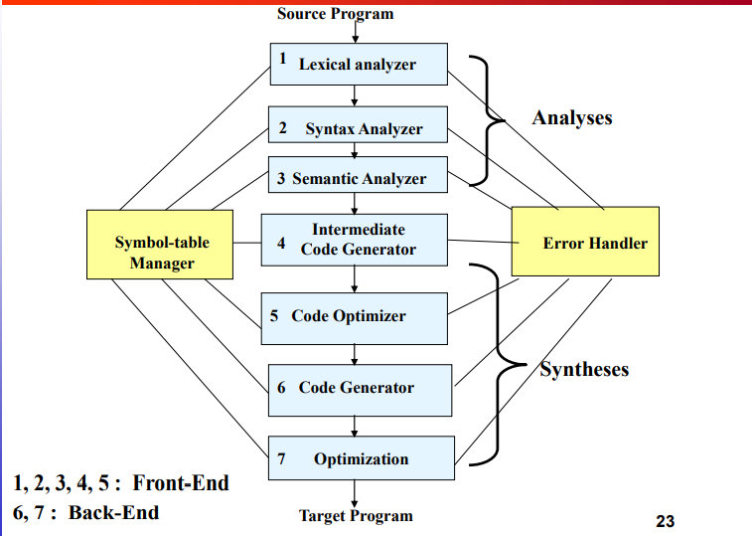
Compiler
Front end – Middle end – Back end
Front end:
Machine independent.
the analysis phase of the
compiler reads the source
program,divides it into
core parts, and then checks
for lexical,grammar,
and syntax errors

Slide 2
Compiler
Front end – Middle end – Back end
Back end:
Machine dependent.
the synthesis phase generates
the target program with the help
of intermediate source code
representation and symbol table.

Slide 3
Compiler
Front end – Middle end – Back end
Middle end:
used to optimize software source code.

Slide 4
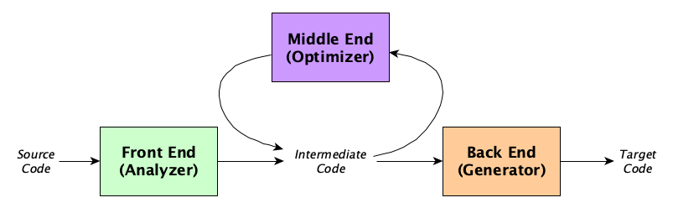
Compiler
Front end – Middle end – Back end

Slide 5
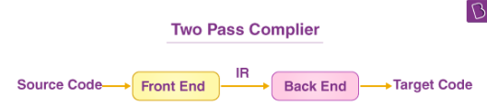
Compiler
Front end – Middle end – Back end
An intermediate representation (IR)
is the data structure or code used internally by a compiler or virtual machine to represent source code.

